Slide 1
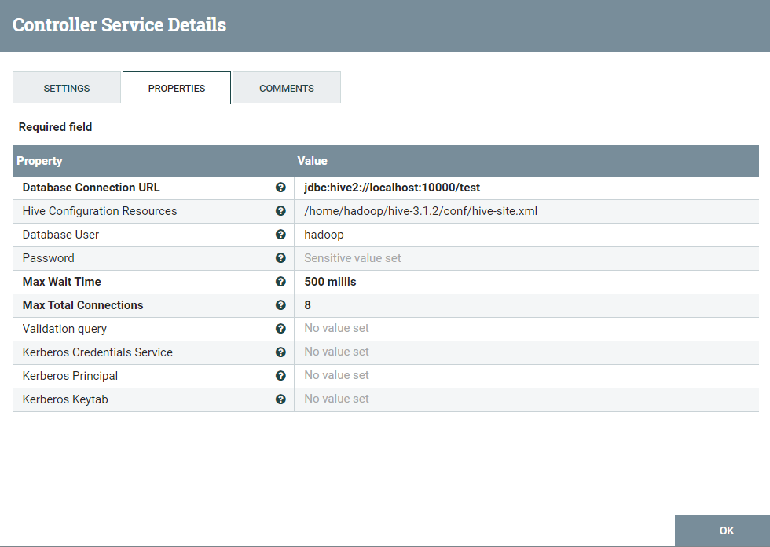
Nifi Controller
1. HiveConnectionPool

Slide 2
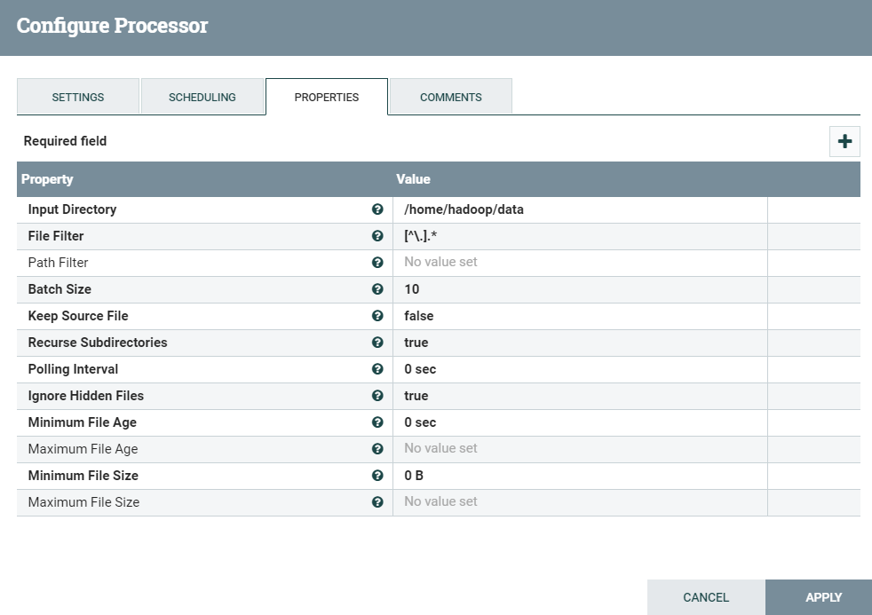
Nifi Processors
2. GetFile

Slide 3
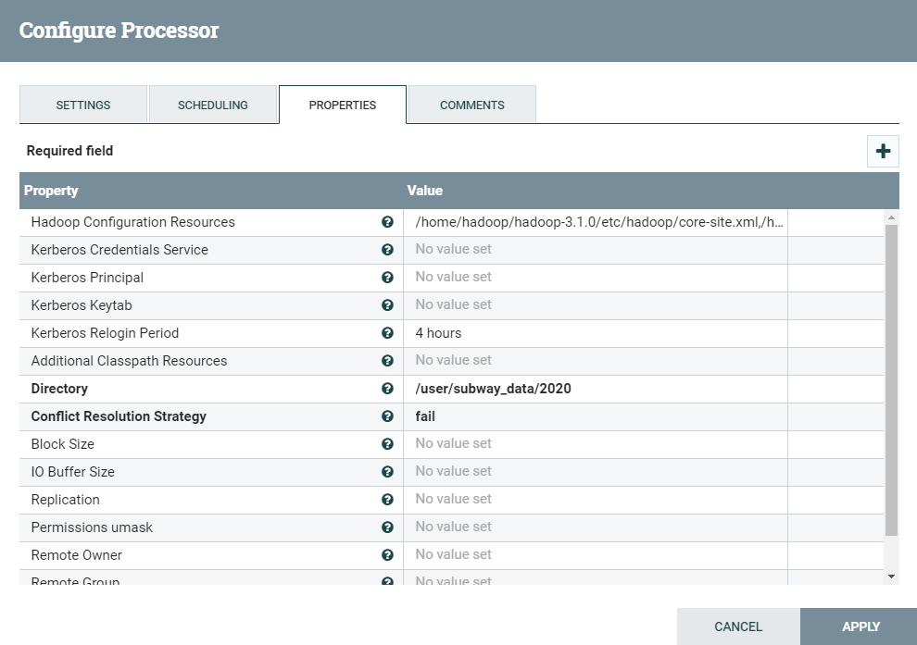
3. PutHDFS

Slide 4
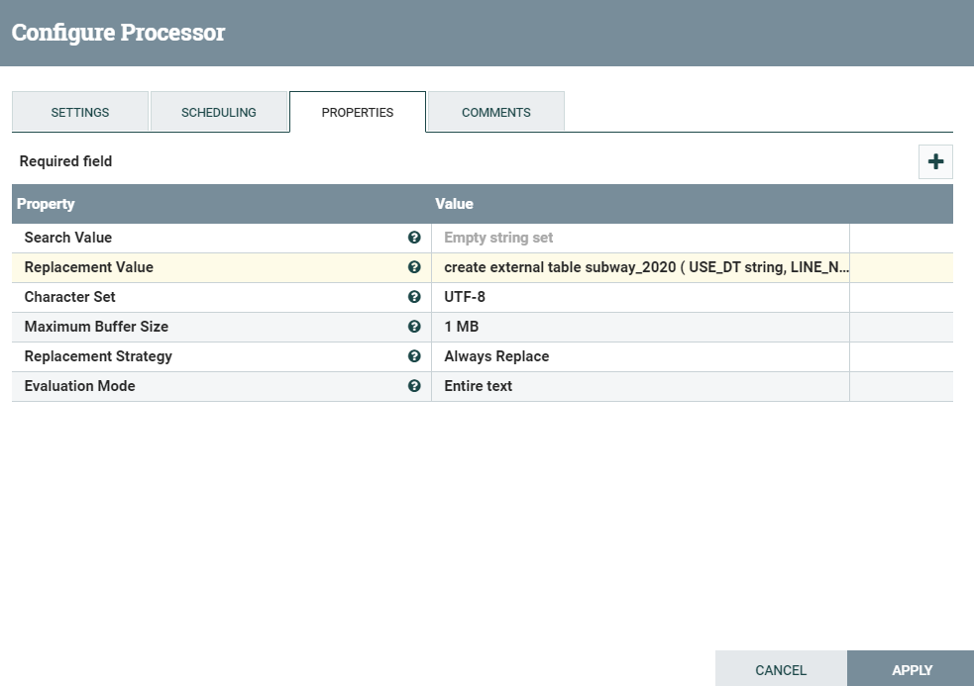
4. ReplaceText

Slide 5
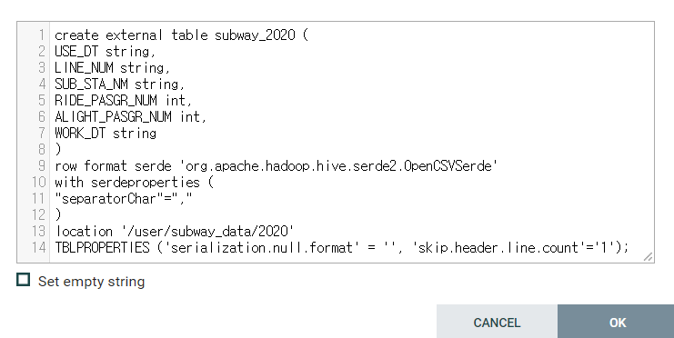

Slide 6
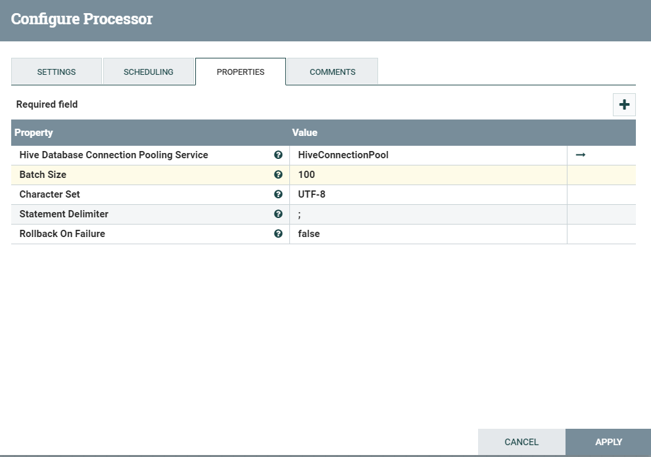
5. PutHiveQL

Slide 7
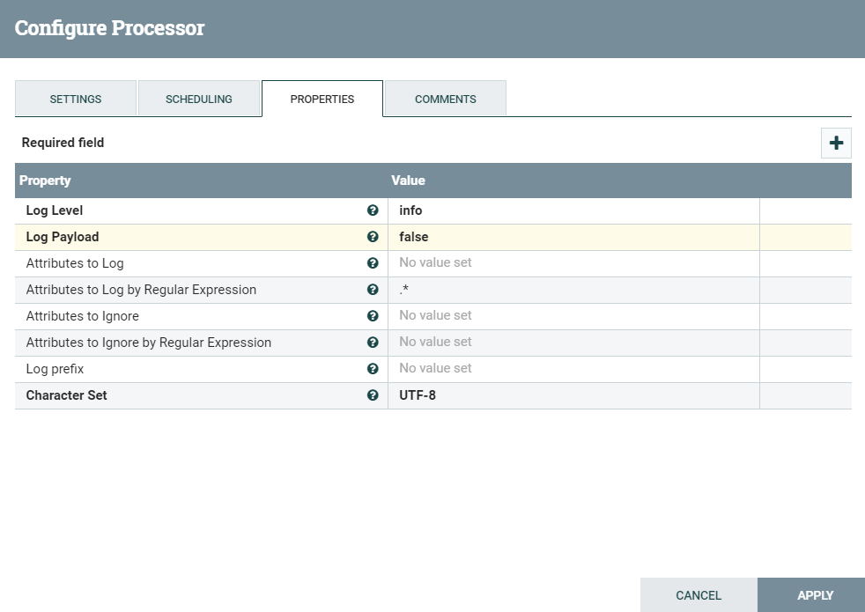
6. LogAttribute

Slide 8
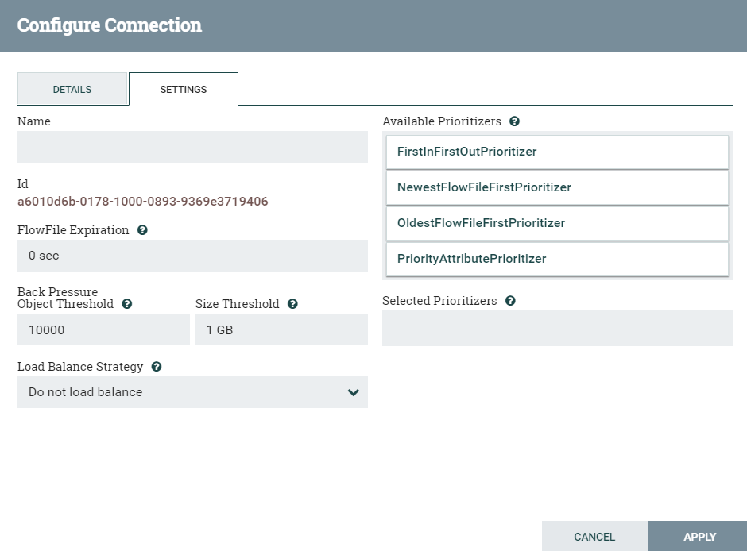
7. Queued

